Slide 1

INTERNSHIP TASK:
CLASSIFICATION ON “STROKE PREDICTION”
Presented By
Laiba Memon

Slide 2
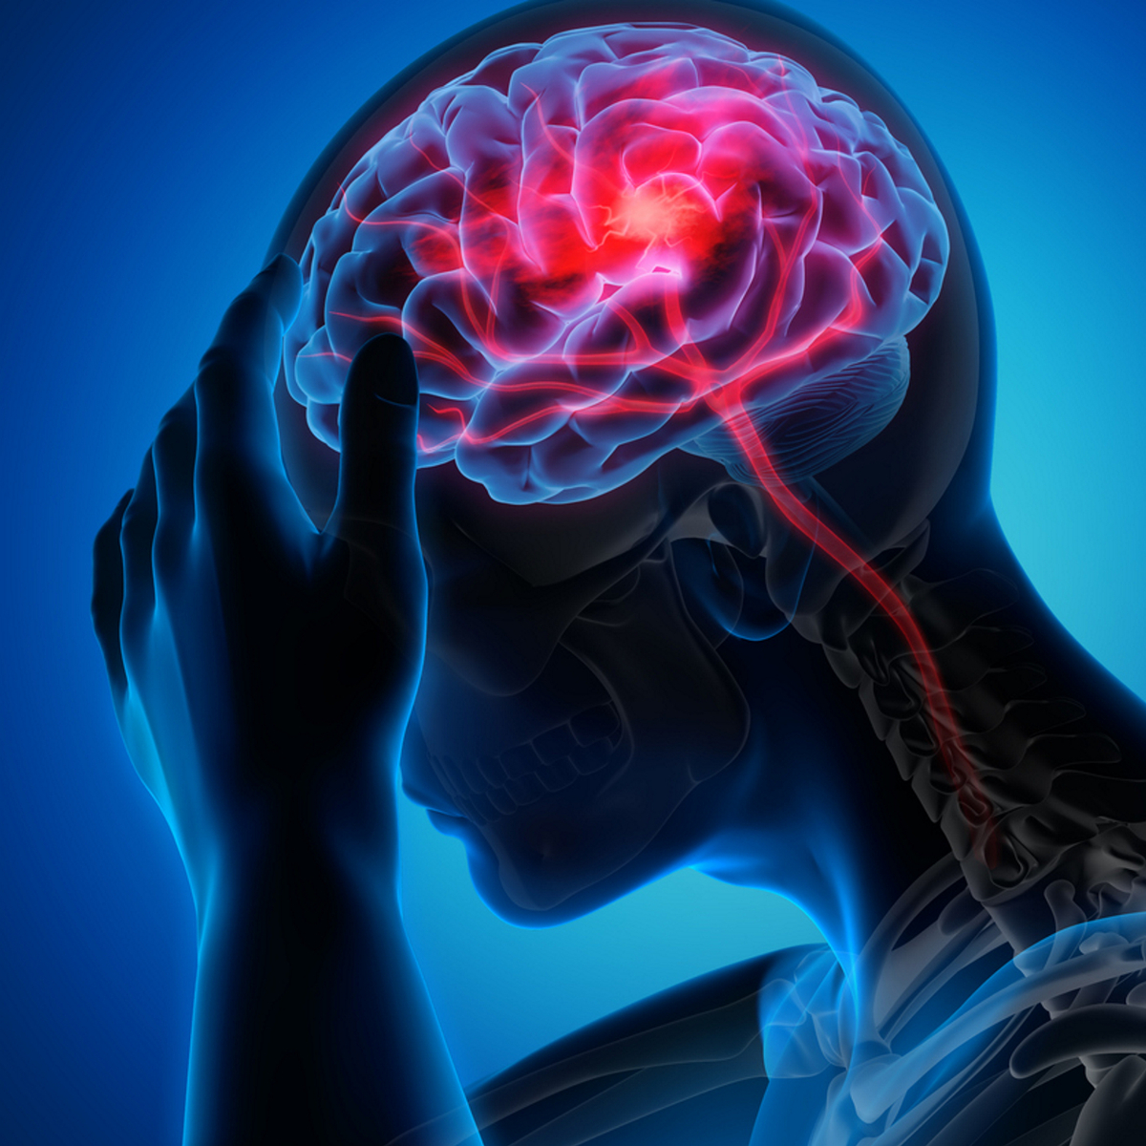
INTRODUCTION
Stroke is a disease that affects the arteries leading to and within the brain. A stroke occurs when a blood vessel that carries oxygen and nutrients to the brain is either blocked by a clot or ruptures. According to the WHO, stroke is the 2nd leading cause of death worldwide. Globally, 3% of the population are affected by subarachnoid hemorrhage, 10% with intracerebral hemorrhage, and the majority of 87% with ischemic stroke. 80% of the time these strokes can be prevented, so putting in place proper education on the signs of stroke is very important. The existing research is limited in predicting risk factors pertained to various types of strokes. Early detection of stroke is a crucial step for efficient treatment and ML can be of great value in this process. To be able to do that, Machine Learning (ML) is an ultimate technology which can help health professionals make clinical decisions and predictions. During the past few decades, several studies were conducted on the improvement of stroke diagnosis using ML in terms of accuracy and speed. The existing research is limited in predicting whether a stroke will occur or not. Machine Learning techniques including Logistic , Decision Tree Algorithms have been used for prediction.

Slide 3
PROBLEMS!
According to the World Health Organization (WHO) stroke is the 2nd leading cause of death globally, responsible for approximately 11% of total deaths. This dataset is used to predict whether a patient is likely to get stroke based on the input parameters like gender, age, various diseases, and smoking status. Each row in the data provides relevant information about the patient.

Slide 4


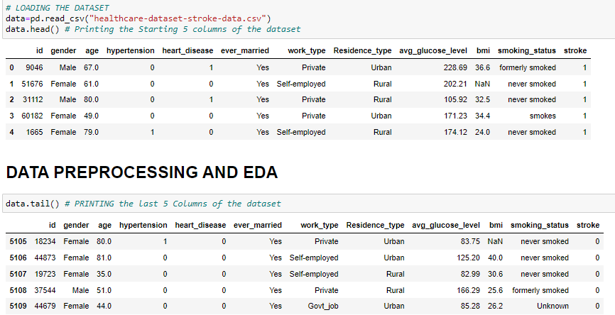
DATASET OF STROKE PREDICTION

Slide 5
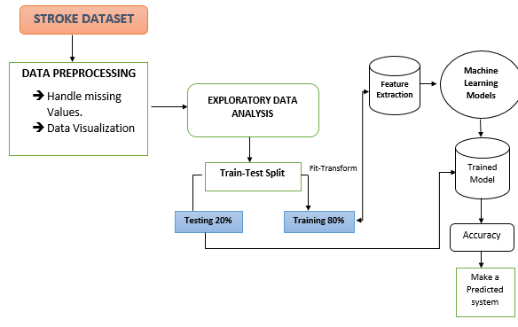
METHODOLOGY/WORKFLOW OF PROJECT

Slide 6
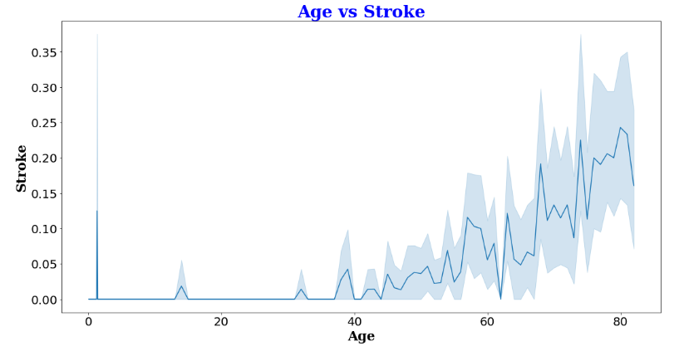
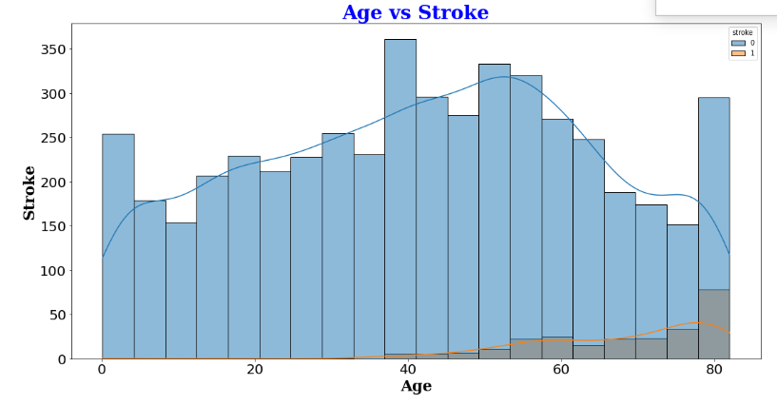
Data Visualization
Fig 1
Fig 2

Slide 7
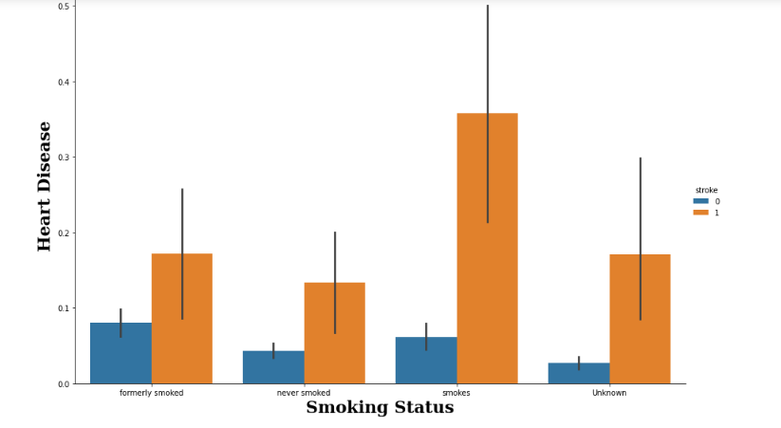
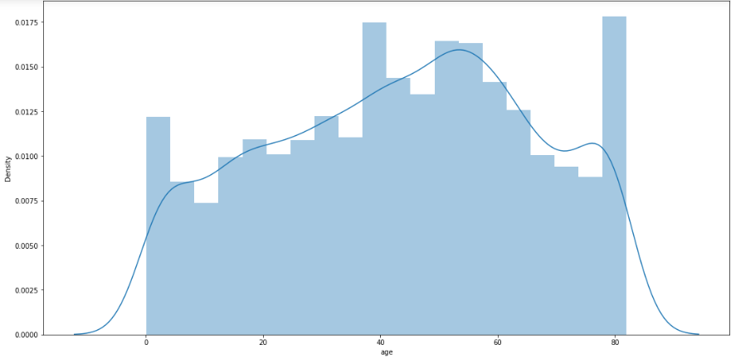
Fig 4:
Fig 3:

Slide 8
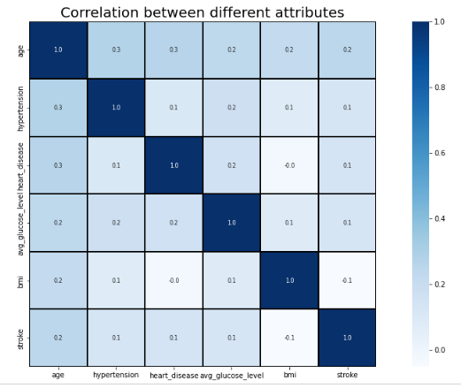
Heatmap to find the correlation between columns

Slide 9
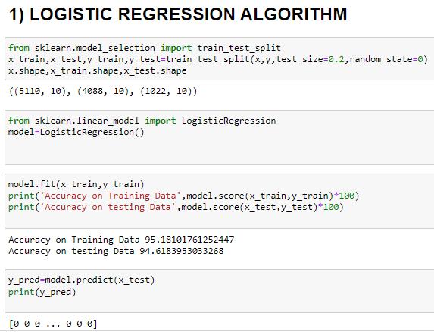
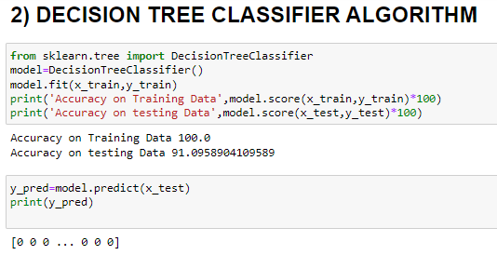
APPLING DIFFERENT MACHINE LEARNING ALGORITHMS

Slide 10
CONCLUSION
By understanding the major and contributing factors of Stroke Prediction, I have developed a model to predict or to classify patients who are most likely to have a stroke. I have identified the factor. Get the most important dataset variables. After applying several algorithms such as Logistic Regression and Decision Tree Classifier for stroke prediction classification, the proposed approach has 95% ​​accuracy among the classification methods as compared with other classification methods.
The Logistics Regression models have performed well compared to Decision Tree Classifier models.
The best performance is given by Logistic Regression model.

Slide 11

THE END

